Slide 1








Presentation
on
“Student Staff management System”
Presented by:
GUIDED BY :
MR. / MS.
Department of Computer Science & Engineering
Session 2020-2021

Slide 2

CONTENT
Introduction
Problem Statement
Aim & Objectives
Literature Review
Software and Hardware requirement
Proposed system
Dataflow Diagram
Project Working
Modules
References
DEPARTMENT OF COMPUTER SCIENCE & ENGINEERING

Slide 3
INTRODUCTION
We have this Student management System where we are able to manage all Possible Stuff to maintained and manage All college and Teaching Staff we maintained all subjects Sessions for several years we have real time data base and pie graph for all progress we can directly and personally message all students and staff and approve or reject for there leave for both Students and Staff
So this System is able to do All possible things to manage college Admin Interface
DEPARTMENT OF COMPUTER SCIENCE & ENGINEERING

Slide 4
PROBLEM STATEMENT
This Student Management System Project features of a new
integrated and collaborative online supervision
system for college administration and dissertation projects. The
system is currently under development and it aims to
ease the supervision process, federate the tasks of all
involved actors and enhance the student learning
experience. Collected feedback from students and
academic staff shows that such a system can help to
maintain an effective and efficient supervision
relationship between all parties.
DEPARTMENT OF COMPUTER SCIENCE & ENGINEERING

Slide 5
AIMS & OBJECTIVE
To build this student management system it helps to manage college administration and management
Using Cloud Base Student management system it helps us to work any ware without and paperwork
It is useful for Students and Staffs to check daily updates from given by HOD head of Department
Admin can manage all students and staff and there attendances there subjects , manage sessions , approve there leaves , response there feedbacks .
So We build and cloud solution for managing all college managements for students and staff.
DEPARTMENT OF COMPUTER SCIENCE & ENGINEERING

Slide 6
LITERATURE REVIEW
According to Freund et al. (2017), nowadays people interact directly with technology
in fields such as education, government, finance, retail, entertainment, health care,
science, travel, publishing, and manufacturing.
And they also state that, educators and teaching institutions use technology to
assist with education. Most equip labs and classrooms with laptops or desktops. Some
even provide computers or mobile devices to students. Many require students to have
a mobile computer or mobile device to access the school’s network or Internet
wirelessly, or to access digital-only content provided by a textbook publisher.
And educators may use a Course Management System (CMS), sometimes called
a Learning Management System (LMS), which is a software that contains tools for
class preparation, distribution, and management. For example, through the course
management system, students access course materials, grades, assessments, and a
variety of collaboration tools.
Many schools offer distance learning classes, where the delivery of education
occurs at one place while the learning occurs at other locations. Distance learning
courses provide time, distance, and place advantages for students who live far from a
campus or work full time.
DEPARTMENT OF COMPUTER SCIENCE & ENGINEERING

Slide 7
HARDWARE & SOFTWARE REQUIREMENT
Hardware :
Any Devices Desktop
laptop
Emulators
Smartphones
Software :
Operating System Windows
Mac
Linux
Android ARM
Terminal :
CMD
Terminals

Slide 8
PROPOSED SYSTEM
The study aims at developing and implementing a web-based student
management system for the College University to, replacing the old
manually done paper work and to minimize the security issues and the problems it possesses.
The proposed is a multi-user system, developed using Python programming
language with localhost (Demo) or paid Server and MySQL DBMS (Database Management System) support.
The system is confined to and intended for the students. They possess there login credentials which Admin Created and students and staff can access it
DEPARTMENT OF COMPUTER SCIENCE & ENGINEERING

Slide 9
DATA FLOW OF PROJECT
Data is collected and entered into the system, typically from a variety of sources such as registration forms, transcripts, and test scores.
The data is organized and stored in a database, where it can be easily accessed and manipulated.
The system provides access to student records, allowing teachers and administrators to view grades, track progress, and more.
Students may also be able to access their own records and view their grades and other information.
The system may include features for data analysis and reporting, such as the ability to generate reports on student performance, class attendance, and other metrics.
These reports can help educators identify trends and patterns in student data, and make data-driven decisions about teaching and learning.
DEPARTMENT OF COMPUTER SCIENCE & ENGINEERING

Slide 10
Data entry: This is the process of entering information about students and their academic records into the system. This information may come from a variety of sources, such as registration forms, transcripts, and test scores.
Data storage: Once the data has been entered into the system, it is typically organized and stored in a database. This allows the data to be easily accessed and manipulated.
Data retrieval: The system provides users with the ability to retrieve and view student records. For example, teachers and administrators may be able to access student grades and track progress, while students may be able to view their own records and grades.
Data analysis and reporting: Some student management systems may include features for data analysis and reporting. For example, the system may be able to generate reports on student performance, class attendance, and other metrics. These reports can help educators identify trends and patterns in student data, and make data-driven decisions about teaching and learning.
PROJECT WORKING
DEPARTMENT OF COMPUTER SCIENCE & ENGINEERING

Slide 11
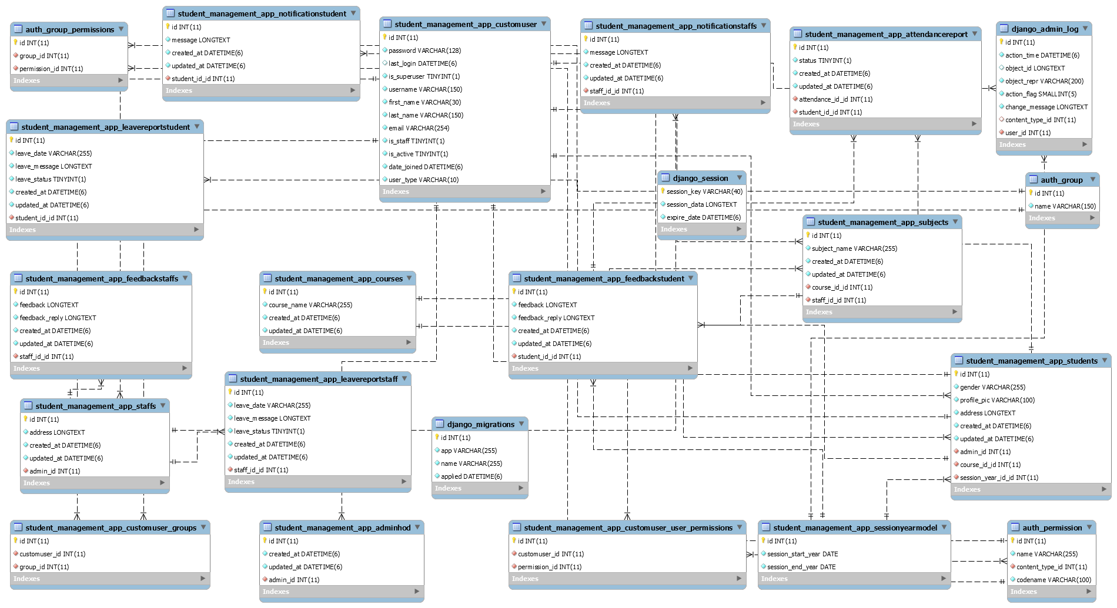
PROJECT WORKING
DEPARTMENT OF COMPUTER SCIENCE & ENGINEERING

Slide 12
MODULES
We use Python Programming Language as back-end and there are some Modules we use to build This System
Django
MySql
Pydot
Graphviz
Pyz
Pillow
Those are some python packages which helps us to manage all Backend modules on python code
DEPARTMENT OF COMPUTER SCIENCE & ENGINEERING

Slide 13
REFERENCES
[1] Kartiki Datakar
, “Online College Management System”,
International Journal of Computer Science and MobileComputing, Vol. 5, Issue 4, April 2016.
[2] Lalit Joshi, “A Research Paper on College ManagementSystem”, International Journal of Computer Applications,
Vol.122, Issue 11, July 2015.[3] Mary Jane Magno-
Tan, “Cloud
-Based College
Management System for Universities”
,
InternationalJournal of Information and Education Technology, Vol.4,Issue 6, December 2014.
[4] S. R. Bharamagoudar, “
Web-Based Student Information
Management System”, International Journal of Advanced
Research in Computer and Communication Engineering,Vol.2, Issue 6, June 2013.[5] Srikant Patnaik,
“College Management System”,
International Research Journal of Engineering andTechnology, Vol.3, Issue 5, May-2016
[6] Vishwakarma R. Ganesh, “Android College Man
agement
DEPARTMENT OF COMPUTER SCIENCE & ENGINEERING

Slide 14
THANK YOU

